Slide 1

DIO CORPORATION Business model
DIALLO Ibrahima
OKE Moucharaph
DJIMERA Bouna Seyré

Slide 2
EXECUTIVE SUMMARY
IDEA
PROBLEMS
SOLUTIONS

Slide 3
IDEAS
Problems
Doing an action for the planet
Old mobiles can be repaired, reconditioned and resold
The distribution of digital emissions according to sources shows that 63% of CO2 emissions are caused by equipment that includes smartphones
According to ADEME (French Environment and Energy Management Agency), only 15% of phones at the end of their useful life are collected and at least 30 million cell phones are sleeping in our drawers

Slide 4
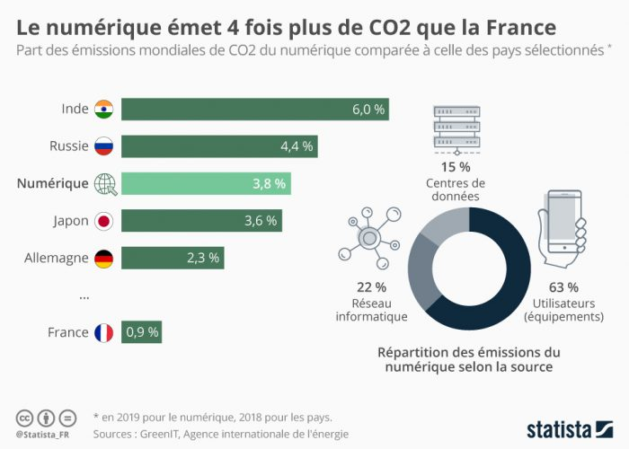
Problems

Slide 5
SOLUTIONS
Reconditioning of smartphones to give a second life to these products
Allow consumers who have an interest in green products and those who do not have sufficient resources to access high-end products by offering them a reasonable price
Encourage the retirement of cell phones from their drawers by offering them financial compensation

Slide 6
COMPAGNY PRESENTATION
TEAM
LOGO
STRUCTURE

Slide 7
Team
Three Master's students in Data Science having interest in protecting the ecosystem.
Employees with not only individual competencies (technical, interpersonal skills and expertise) but also collective competencies
We need creative employees with self-confidence, entrepreneurial spirit and a great taste for the environment
Human capital is an important factor for business performance and gives competitives

Slide 8
Logo and Structure
Loyalty to customers and employees
Innovation
Respecting the environment, developing a more ethical business model
Our team has the necessary skills in the field of smartphone reconditioning. We initially target households and intend to expand our offerings to large companies in the long term.

Slide 9

Product Service Project

Slide 10
Product Service Project
Product
Our production will be mainly reconditioning
Collect or buy telephones with minor defects
Services
we will proceed to repair these devices in our workshops
Our product will be sold on the market
Our customers will be given the opportunity to take back their phones and make exchanges.
e-commerce, prices, labor and repair guarantees.
Project
create partnerships with telephone operators who often receive phone returns from their customers in return.

Slide 11
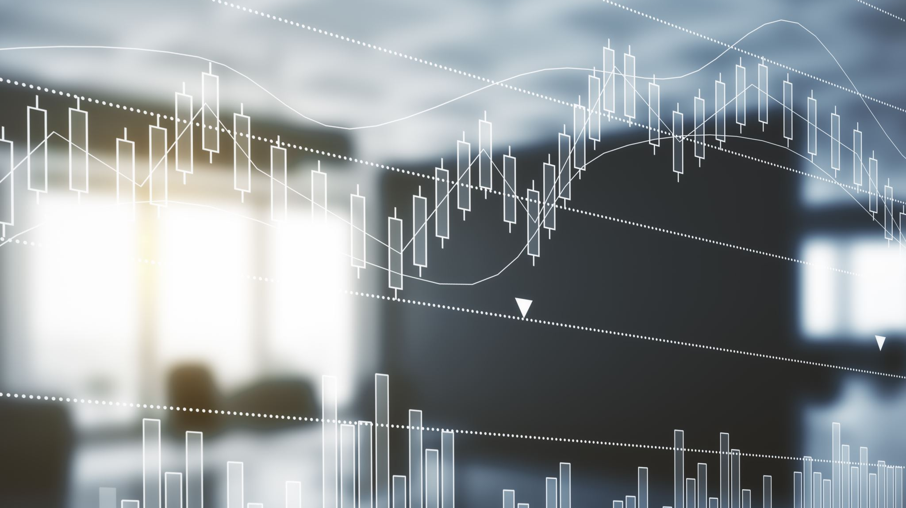
Market analysis
political
economic
social
technical
environmental
legal

Slide 12
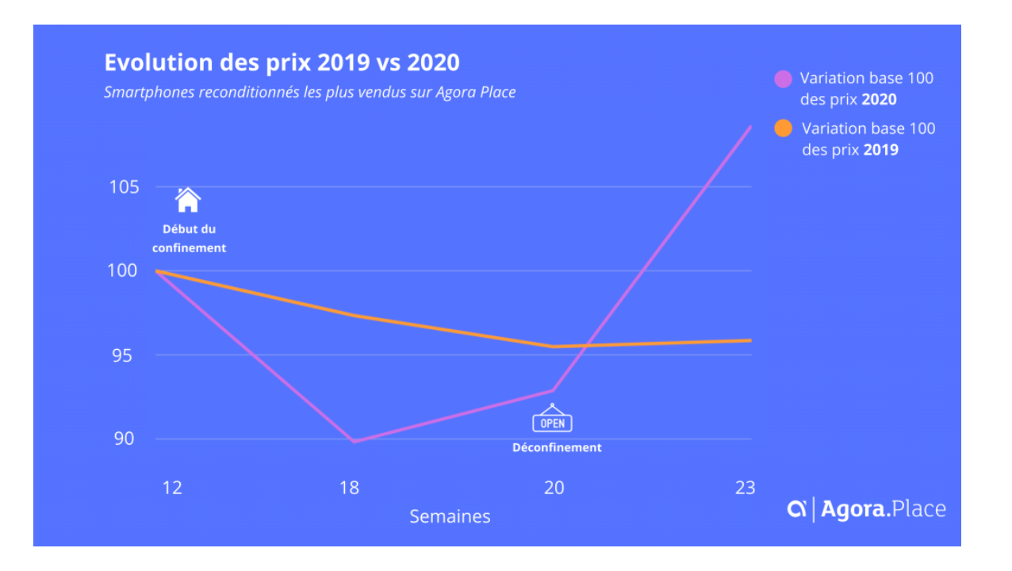
Market analysis
Economic
main factors in the purchase decision for used products(price, having a warranty on the product)
main obstacle(the lack of visibility on the lifetime of the phone)

Slide 13
SOCIAL AND ENVIRONMENTAL
importance of the smartphone in our society
85 to 95% of the CO2 emissions are due to the use of new smartphones.
38% for a better environmental efficiency,
36% to be paid immediately,
3% to pay less for your future cell phone.

Slide 14
MARKET ANALYSIS
Technical
Investments (Tools, machines....)
Test and repair the phones to their normal state.
Political
Introduction of a reduced vat rate by the government
job creation
protection of the environment.

Slide 15
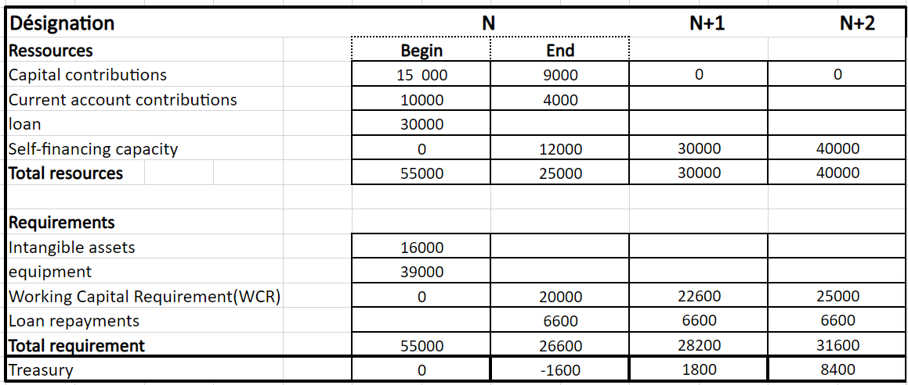
FINANCIAL PLAN

Slide 16
Marketing plan
Objectifs
How?

Slide 17
Marketing plan
Objectifs
Our business objective is to target 10 to 20 new customers per week
increase our sales by 10% over the year by selling at least 50 phones per month for the first two years
How?
Promotions: every February
Prices: below the price of new and up to less than 70% of the price of the new.
Place: From online sales mainly, we also plan to open stores
Products: Reconditioned

